Slide 1
Welcome to Fall 2023
Department of Software Engineering

Slide 2
Washington Accord
Washington Accord (WA): Agreement that establishes equivalence of accredited professional engineering programs of member countries.
Accredited Engineering Graduates are recognized by other signatory countries - Possible employment as engineers in those countries without further examinations.

Slide 3
Washington Accord
Members
Established in 1989, as of 2017, the full members of WA: Australia, Canada, China, Chinese Taipei, Hong Kong, India, Ireland, Japan, Korea, Malaysia, New Zealand, Russia, Singapore, South Africa, Sri Lanka, Turkey, United States, United Kingdom and Pakistan
The provisional members of the WA : Bangladesh, Costa Rica, Mexico, Peru and Philippines

Slide 4
Why Outcome Based Education (OBE) ?
To address mismatches between employers and graduates.
Students main concerns are GRADES, Employers are looking for KNOWLEDGE, ATTITUDE and SKILLS.
OBE is a process that involves assessment and evaluation practices in education to reflect the attainment of expected learning outcomes and showing mastery in the program area.

Slide 5
OBE Framework
BSE Programme

Slide 6
Background
For OBE system implementation of BSE Program, the University Vision, University Mission, Program Educational Objectives (PEOs), Program Learning Outcomes (PLOs), Course Learning Outcomes (CLOs) should be mapped.
University Vision
University Mission
Program Educational Objectives
Program Learning Outcome
Course Learning Outcome

Slide 7
University Vision
To become a knowledge and creativity driven international university that contributes towards development of society.
University Mission
To ensure academic excellence through deliverance of quality education and applied research in a collegiate environment having strong linkages with industry and international community to meet the societal challenges.

Slide 8
BSE Program Educational Objectives
Graduates from Bachelor of Software Engineering program are expected to achieve the following Program Educational Objectives and would possess the ability to:
PEO 1:
Graduates should demonstrate competence in applying Software Engineering principles & practices in various phases of software/system development lifecycle in their respective professional career.
PEO 2:
Graduates should demonstrate effective team member or leadership skills with strong managerial skills and a sound sense of social responsibility for the sustainable development of society.
PEO 3:
Graduates should demonstrate sustained career development and progression through ethical engineering practices, effective communication skills and continuous learning.

Slide 9
PLOs (Attributes)

Slide 12
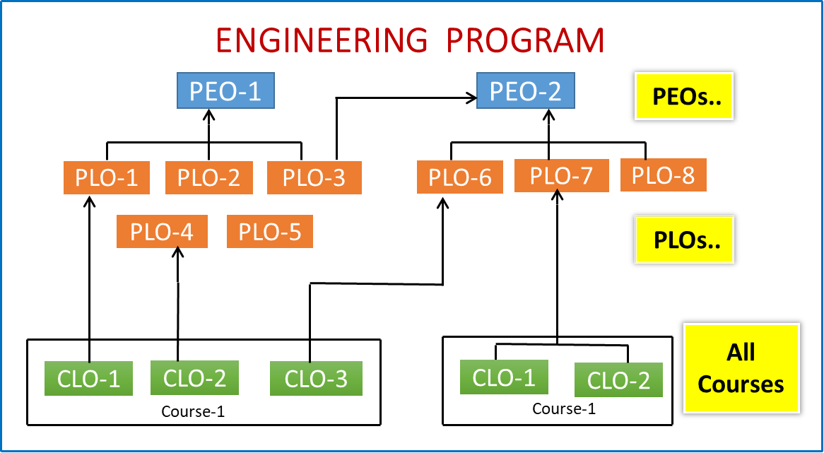
Design Structure of OBE
Inclusion of Complex Engineering Problems
Open Ended Labs

Slide 13
OBE Learning Domains – Bloom’s Taxonomy
Cognitive Level
Knowledge – C1
Comprehension –C2
Application –C3
Analysis –C4
Synthesis–C5
Evaluation– C6
Involving intellectual
activities
What the learner knows
Cognitive
Psychomotor Level
Perception – P1
Set –P2
Guided Response –P3
Mechanism –P4
Complex Overt Response –P5
Adaptation – P6
Origination – P7
LEARNING DOMAINS
Response involving motor and
psychological components
What learner able to perform
Affective
Psychomotor
Affective Level
Receiving – A1
Responding –A2
Valuing –A3
Organization–A4
Characterization –A5
the manner in which we deal with things emotionally, such as feelings, values, appreciation, enthusiasms, motivations, and attitudes

Slide 14
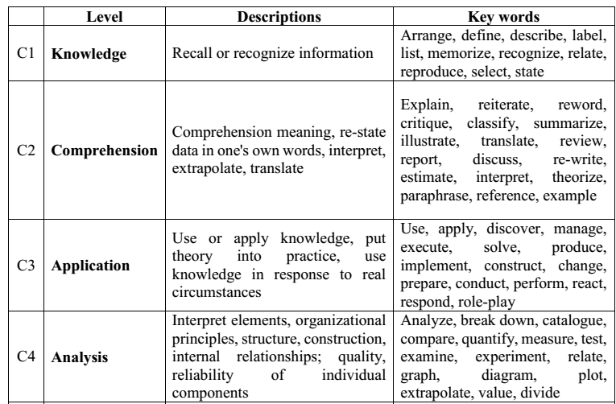
Cognitive Domain

Slide 15
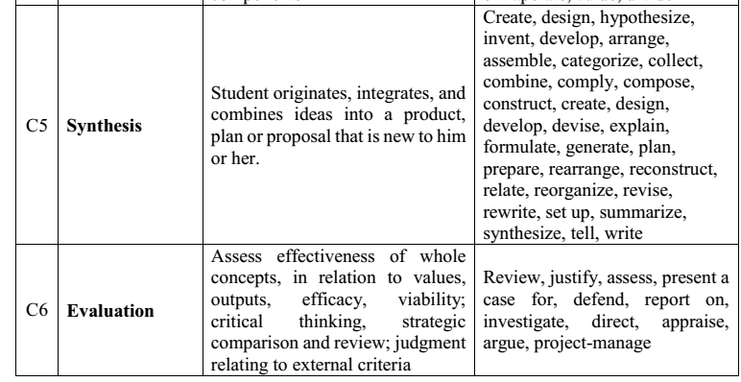
Cognitive Domain

Slide 16
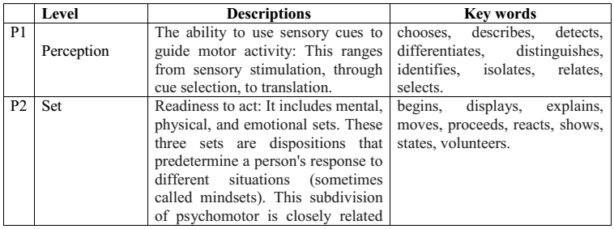
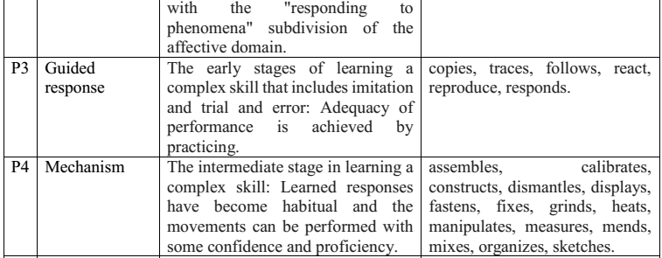
Psychomotor Domain

Slide 17
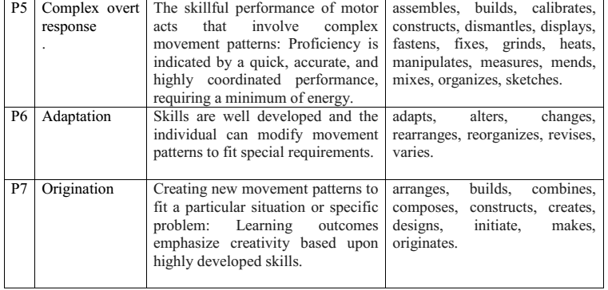
Psychomotor Domain

Slide 18
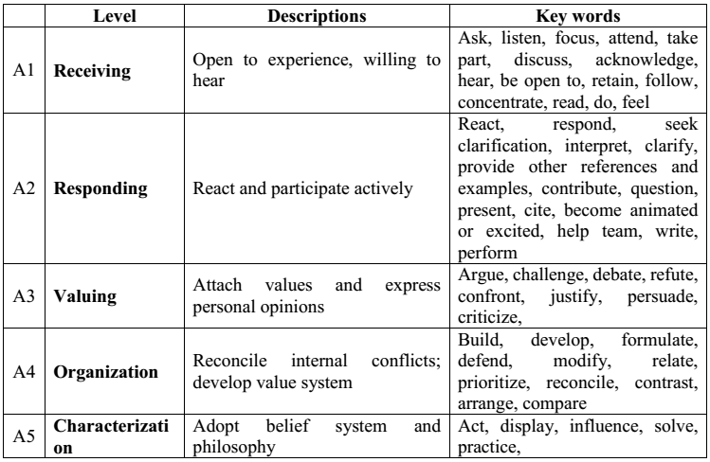
Affective Domain

Slide 19
Software Requirement Engineering
Course Title: Software Requirements Engineering
Course Code: SEN211
Credit Hours: 3 + 0
Prerequisite: (SEN-120 + Introduction to Software Engineering)
Class & Section: BSE-3 A,B,C
Objectives: | This course introduces students to the process of requirements engineering and helps them understand important issues in requirements engineering. It will also help them to learn and apply the RE concepts for elicitation, specification, modeling and analysis of software requirements. Important topics include Requirement engineering types, Requirements management and validation of requirements

Slide 20
Software Requirement Engineering
CLO | Statement | Bloom’s Taxonomy | PLO
1 | Describe various software requirement needs for a variety of stakeholders/situations | C1 | PLO1
2 | Apply requirements engineering activities & processes to any given situation | C3 | PLO2
3 | Analyze various requirements engineering tools & techniques suitable for a given situation | C4 | PLO2
4 | Compile a software requirement specification document | C5 | PLO3

Slide 21
Marking Scheme
Evaluation Instruments (EI) | Marks
Quizzes | 10
Assignments /Project | 20
Mid Term Examination | 20
Final Term Examination | 50

Slide 22
Database Management System
Text Book:
1. Karl Wiegers & Candase Hokanson, (2023). Software Requirements Essentials, 1st Ed, ‎Addison-Wesley.
2. Karl Wiegers & Joy Beatty, (2013). Software Requirement, 3rd Ed, Microsoft.
Reference Books:
Elizabeth Hull, Ken Jackson, Jeremy Dick (auth.)-Requirements Engineering-Springer-Verlag London (2011)
Dean Leffingwell, Don Widrid, Managing Software Requirements
Online References:
https://me2013regulation.wordpress.com/2014/06/24/cp7007-software-requirements-engineering-notes/
http://www.utdallas.edu/~chung/SYSM6309/syllabus.htm
http://wwwagse.informatik.uni-kl.de/teaching/re/ws2015/

